Slide 1
E-Commerce Product Delivery Prediction
Ankush Shyamal

Slide 2
E-Commerce Product Delivery Prediction
Load Data
Data Overview
Exploratory Data Analysis
Data Preprocessing & Feature Engineering
Model Building & Comparison
E-Commerce Product Delivery Prediction
Objective - To develop a robust machine learning classification model that utilizes historical data to predict the probability of a shipment reaching the customer on time.
Motivation - Use machine learning to spot and reduce delays, keeping customers happy and operations efficient.
Deliverables –
A. Documented machine learning models specifically designed for predicting product delivery timeliness.
B. Comprehensive data visualizations illustrating relationships between various factors and delivery performance.
C. A comparative analysis of different machine learning algorithms for this classification task

Slide 3
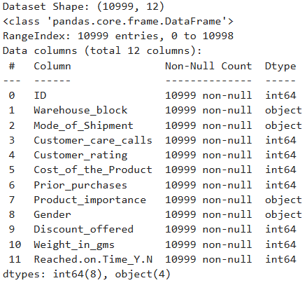
Data Overview
The dataset consist of 10999 observations and 12 feature out of that 6 numeric column 4 categorical column 1 target variable(Reached on time Y.N) and one id column.

Slide 4
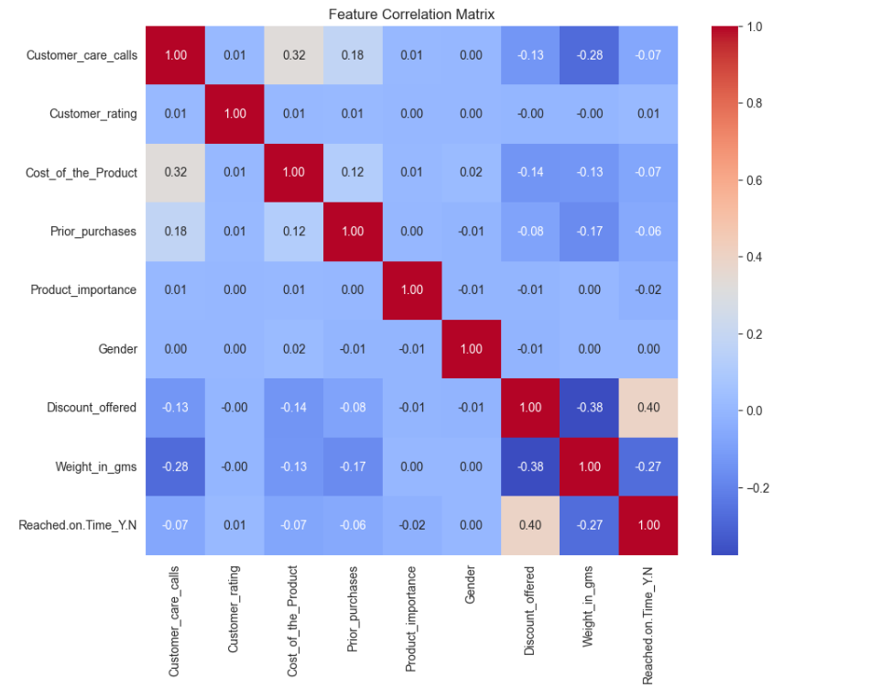
Exploratory Data Analysis(EDA)
EDA TECHNIQUES
Target variable distribution
Numerical feature distribution
Categorical feature distribution
Impact of discount on delivery time
Correlation heatmap

Slide 5
Data Preprocessing and Feature Engineering
Encoding Categorical Variables :
Non-numeric columns such as product importance and gender were transformed using Label Encoding and Warehouse block and Mode of Shipment were transformed using One-Hot Encoding for model compatibility.
Dataset Balancing & Splitting :
The data was checked for imbalance and then split into training and testing sets to prepare for model building(For KNN and Logistic Regression).
Feature Scaling:
Numerical features with wide value ranges were scaled (using StandardScaler) to improve model stability and convergence.

Slide 6
Model Building and Comparison
Logistic Regression
Decision Tree
Random Forest Classifire
K Nearest Neighbour(KNN)
Model Used
I applied Logistic Regression, Decision tree, Random Forest Classifier and K Nearest Neighbour(KNN) to predict the delivery is on time or late.
Classification Report
Accuracy – Shows the overall correctness of the model.
Precision – When you said something was positive, how often were you correct.
Recall – Out of all actual ‘On Time’ cases how many did the model manage to find.
F1 Score – A number that balances the precision and recall.

Slide 7
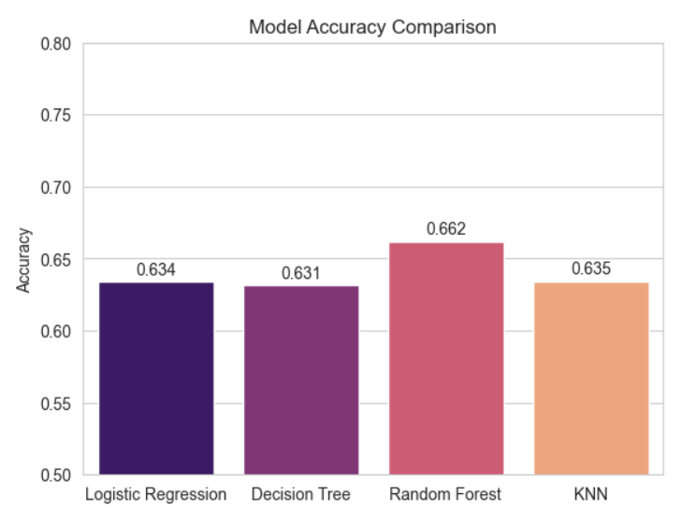
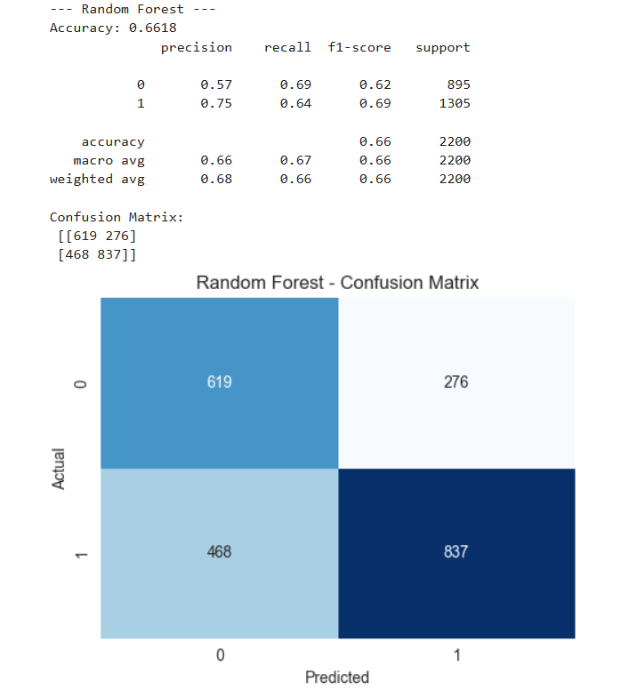
Model Building and Comparison(Visualisation)

Slide 8
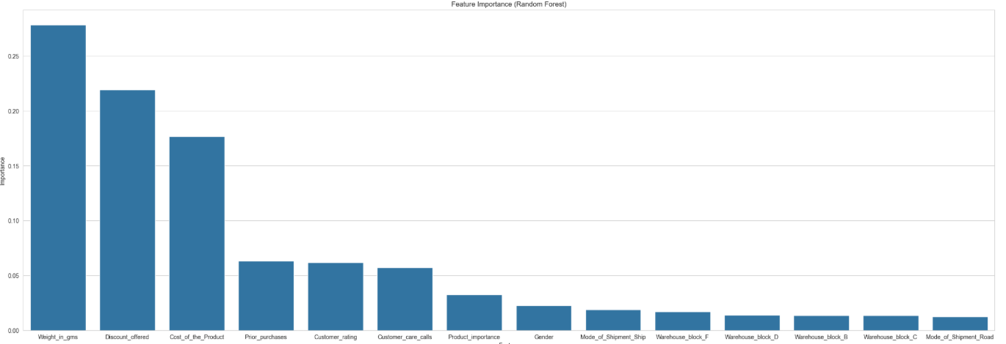
Feature Importance of Best Model
Discount offer is the most important feature to predict the delivery delays.
Weight in gms and cost of the products are the most influential feature where as gender, warehouse block, mode of shipment have minimal impact on models prediction.
Prior purchase and customer care call have moderate importance to models prediction.

Slide 9
Conclusion and Recommendation
Conclusion :The most significant predictors of a late delivery are the Discount Offered and the Weight of the product, whereas Customer Gender and Product Importance had minimal impact.
Recommendation :
Business Impact :
Create a Priority lane in the warehouse for items tagged High Importance so they move faster.
Route all High Importance items only through Blocks A and C.
Cost Impact :
Try to shift the product by road and ship Because flight shipment are costlier/complex and do not deliver the product in proper time.
2. Try to fix the discount logistics cause hight discount are always deliver late delivery and it is also effecting companies revenue.

Slide 10
Thank You!

